Slide 1
Laser Show

Slide 2
What is a laser lighting show?
A laser lighting display or laser light show involves the use of laser light to entertain an audience. A laser light show may consist only of projected laser beams set to music, or may accompany another form of entertainment, typically musical performances.

Slide 3
HOW TO..?
Start off with searching the market for a suitable laser device(keep in mind the event you are using it for).
Don’t impulse buy with these as they are very expensive!

Slide 4
What NOT to do !
Don’t use laser that can damage the eye.
Don’t buy/hire lasers for indoor uses for an outdoor venue.

Slide 5
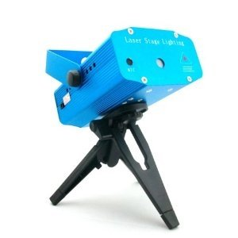
Equipment you’ll need …
The laser scanner
The laser emits light in a straight projection.
It has a great effect and can emit many different colours.

Slide 6
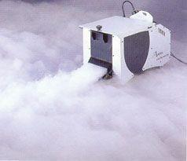
Equipment you’ll need …
Smoke machine
The smoke machine provides a visual effect. Aswell as the effect of smoke, it also reflects the light of the lasers and provides a separate visual effect.

Slide 7
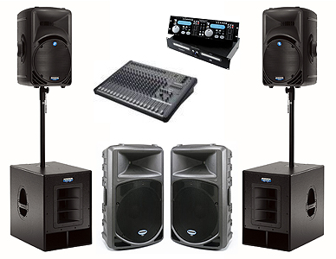
Equipment you’ll need …
Sound equipment
Sound equipment adds an audio aspect to your visual show. This can be used to draw in the viewer and captivate the audience of your laser show.

